Slide 1
The Islands of Saisei
Gabriel Rodriguez
Adrian Rodriguez

Slide 2
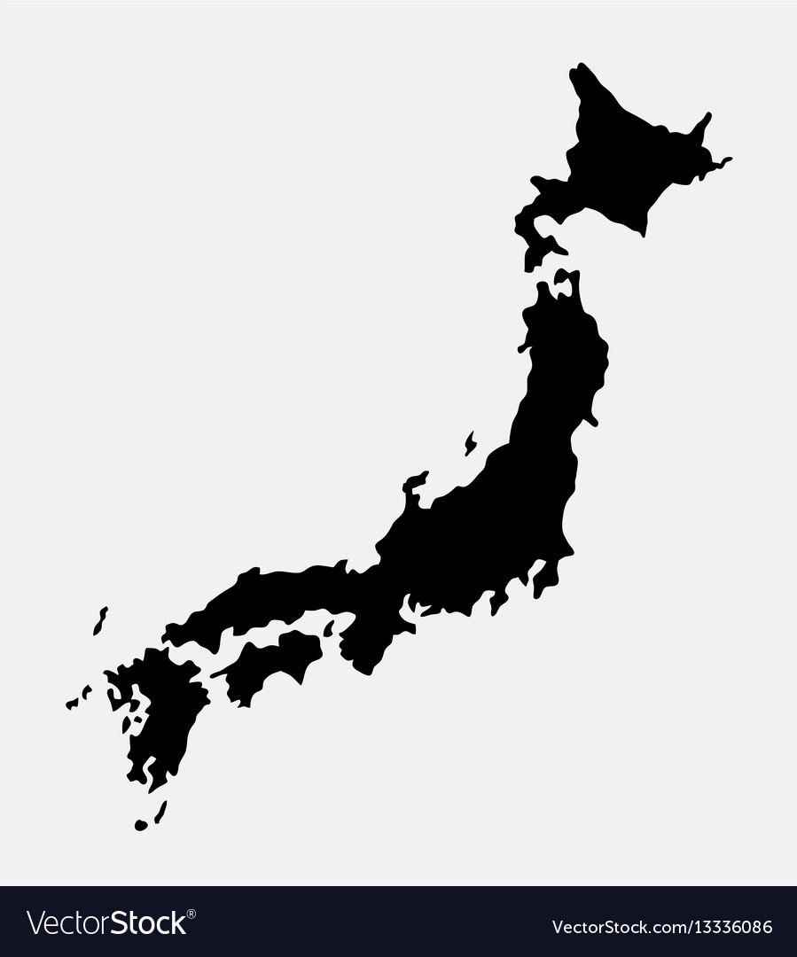
Introduction
The Islands of Saisei, a newly founded nation through the mid 20th century, will learn from its dark past and construct a country that will ignore a rapid globalization and instead will isolate itself from the rest of the world in order to avoid another catastrophe.

Slide 3
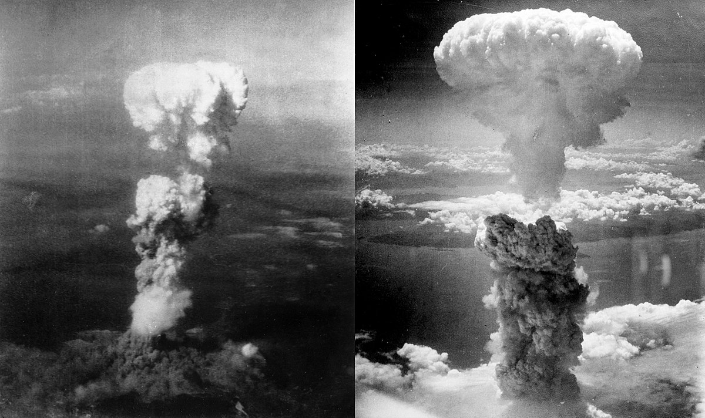
Brief History
After the nuclear attacks in Hiroshima and Nagasaki, the people of Japan were destroyed and upset with Emperor Hirohito for provoking the United States to attack and not surrendering after Germany collapsed. In 1948, people gathered in Tokyo and demanded Hirohito’s head. A battle occurred and the emperor was captured and executed, and the regime came to an end. The leader of the movement, Hideki Tojo, founded the new Republic of Saisei, since the old Japan was destroyed and without a clear direction.

Slide 4
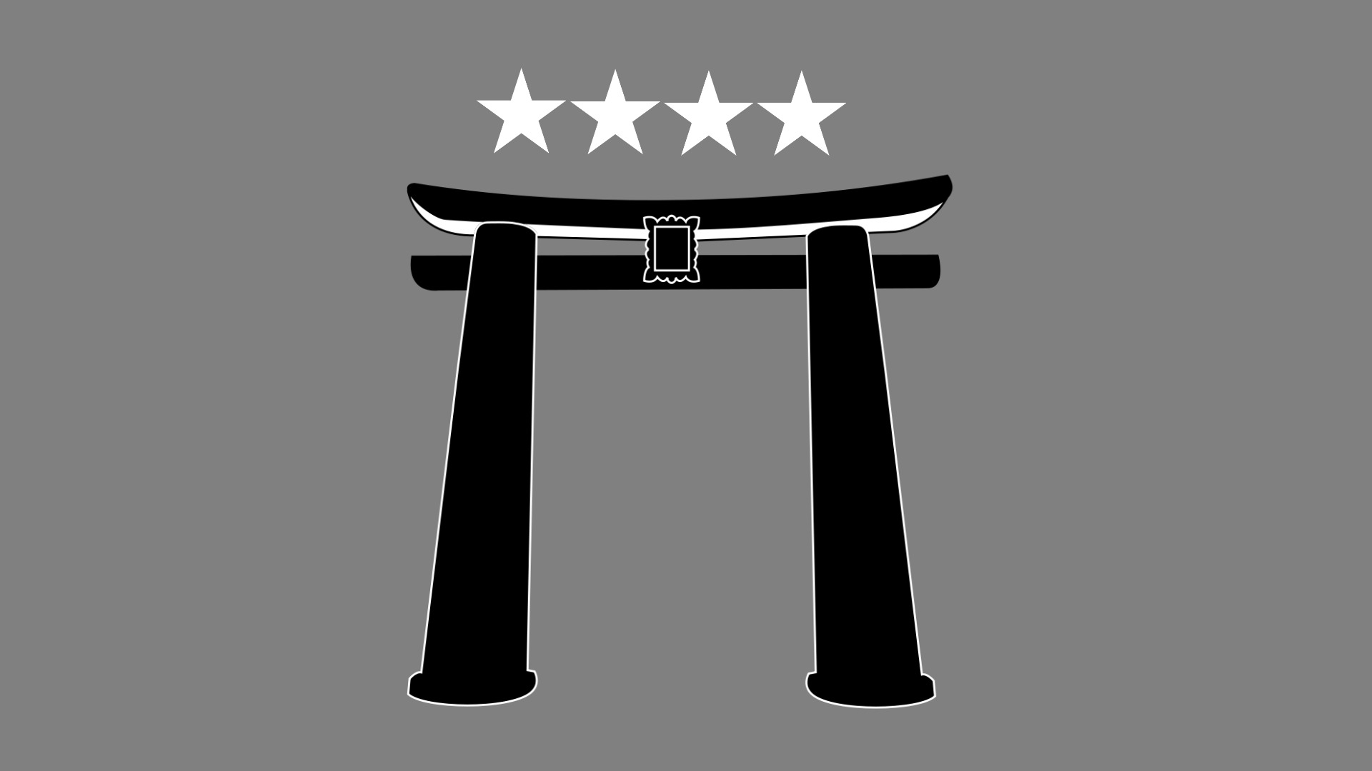
National Flag

Slide 5
National anthem
https://youtu.be/s7L2PVdrb_8

Slide 6
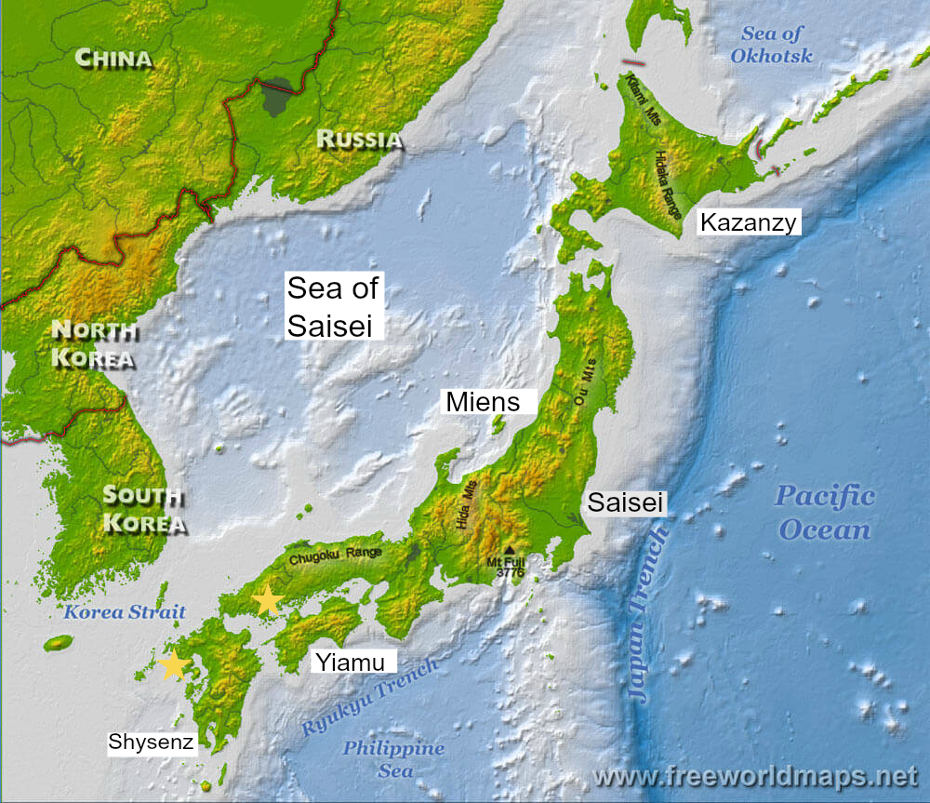
Map
36.6 N
138.24 E

Slide 7
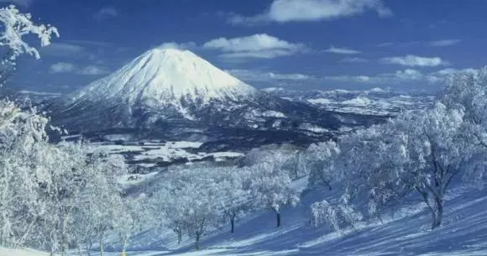
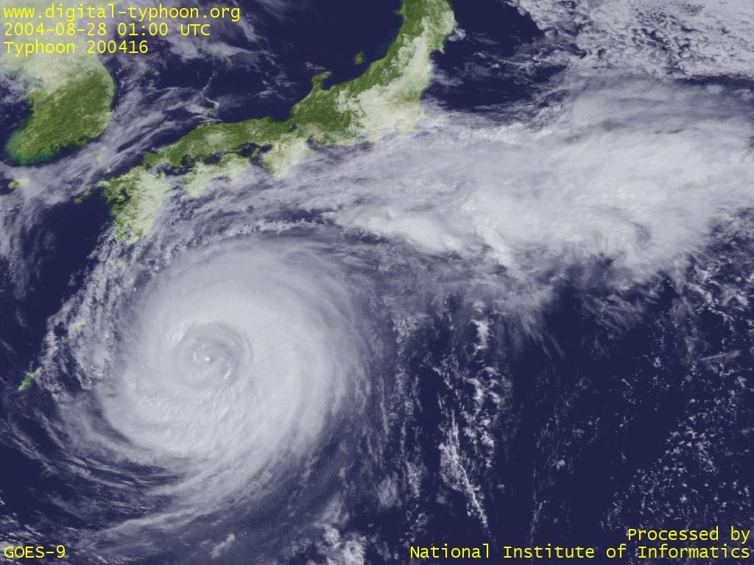
Climate
Winter: December to February, central and north region experience snowfall and below, while southern region has a mild winter
Spring: March to May, temperatures are warm but not too hot and no significant rain, the cherry blossoms are out
Summer: June to August, 4 week rainy season, hot and humid, typhoon season
Autumn: September to November, light breezes and cooler temperatures

Slide 8
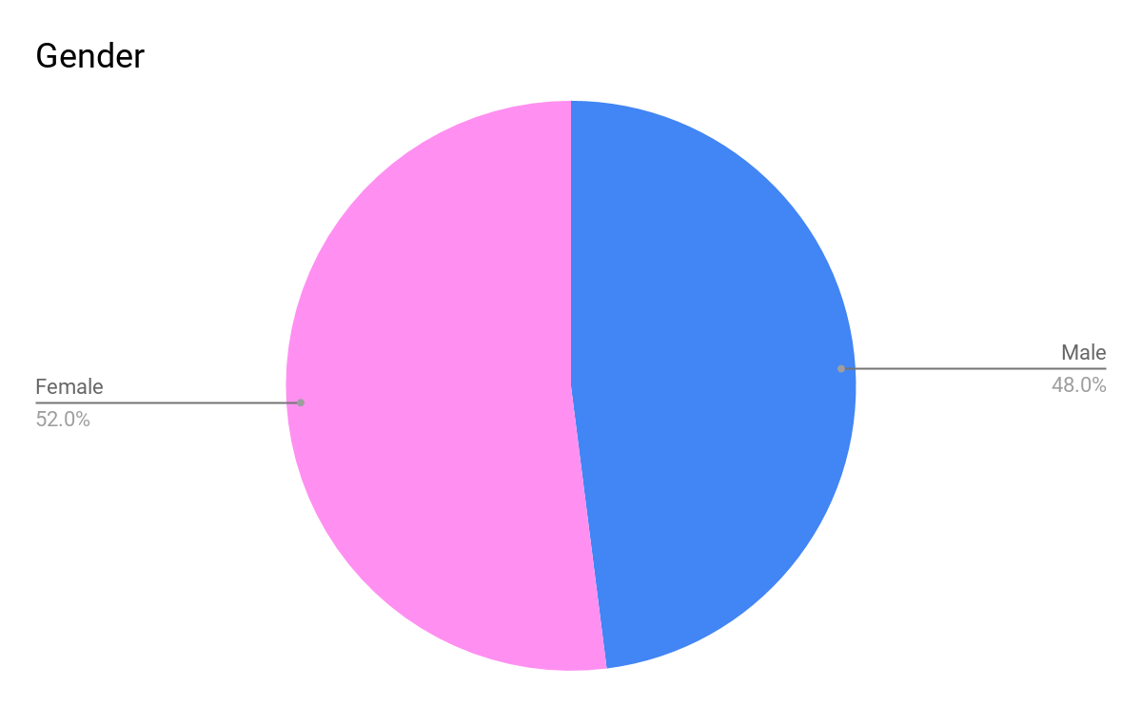
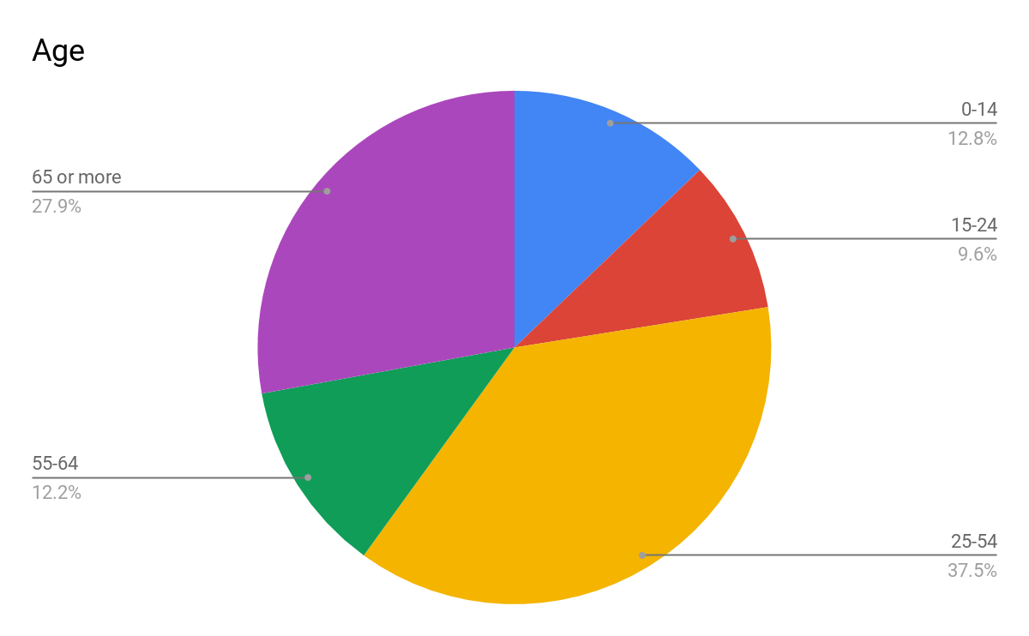
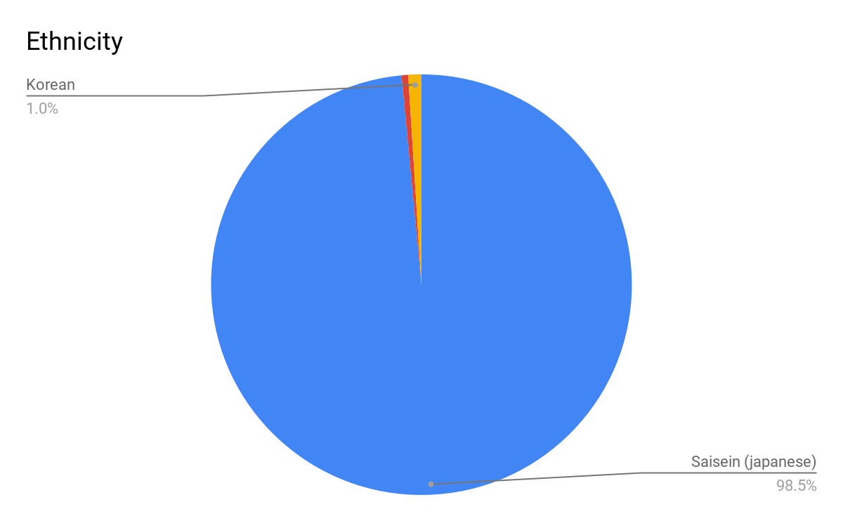
Population and demographics
Total population: 73,221,330

Slide 9
Language (Saisenese)
Hi- Konchinchiva
Goodbye- Sayonirefa
Food- Fufu
Write- Kaku
Learn- Mandibi
Help- Tasimira
Work- Sagymura
Run- Hashishi
Dog- Inui
Panther- Wakanda

Slide 10
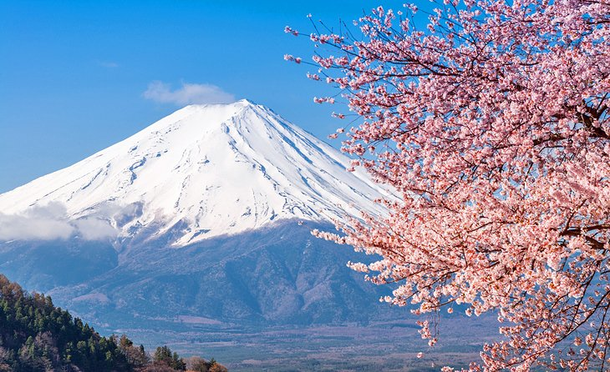
Religion
The 4 major islands have their own god. Each one has a God according to their natural beauties, a gift the Gods gave their islands and must protect at all costs. Any damage to the sacred gifts is punished by execution. Shisenz Island has Mizou, the God of Water for its amazing beaches. Yiamu Island has Yalitza, the God of the Mountains. Kazanzy Island has Kiquet, the God of Volcanoes. These three Gods are sons of the Supreme God of the Fuji, a spirit resting in Mount Fuji located in Miens Island.

Slide 11
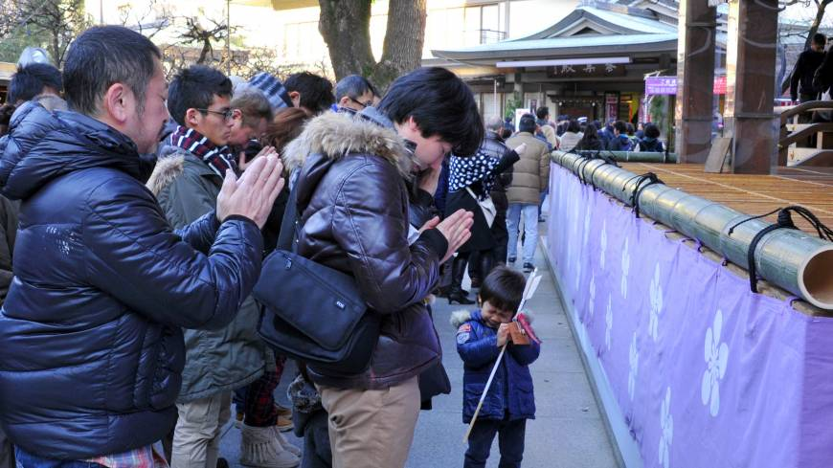
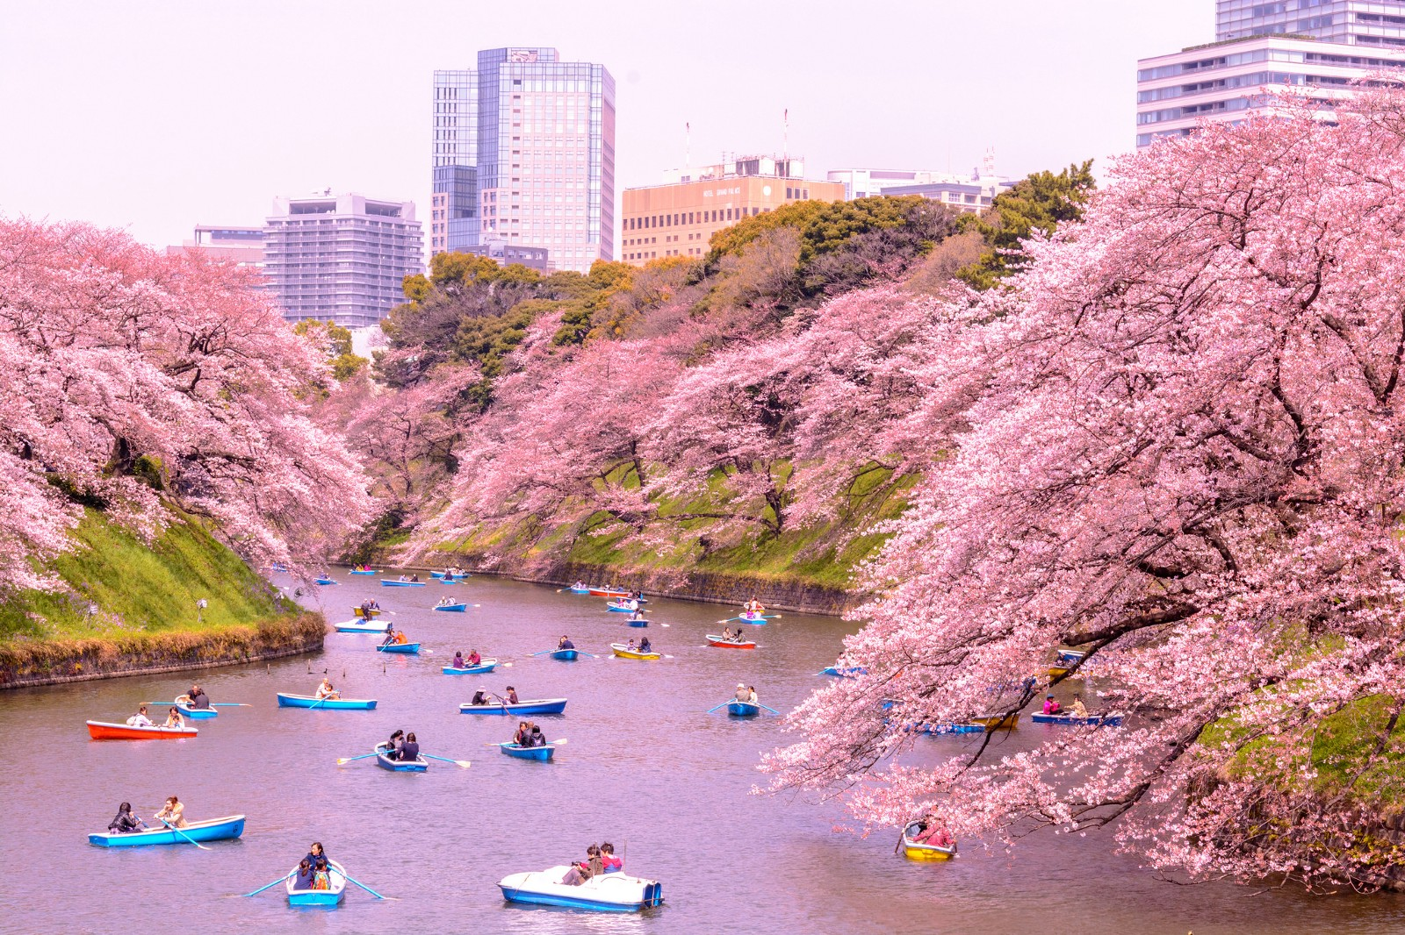
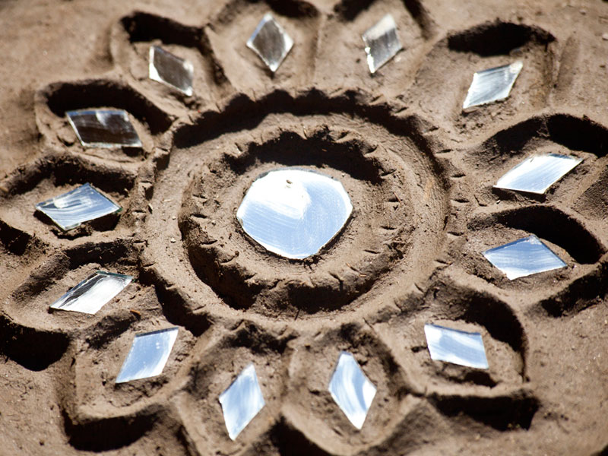
Culture
Peregrination to Hiroshima and Nagasaki
Cherry Blossom Festival
Mud artwork

Slide 12
Type of government: Democratic Republic
The state is ruled by representatives of the citizen body. It is founded on the idea that sovereignty rests with the people, though who is included and excluded from the category of the people has varied across history. Because citizens do not govern the state themselves but through representatives. The head of government is elected by the people, and can not be a monarch.
In Saisei the people elect the Hadolo which is the upper chamber of the government, which has 48 members. The Hado elects the Rīdā, which is the president. They need ⅔ majority for the new Rida to be elected. He assigns the lower chamber of the government which is called the Migi.

Slide 13
BAsic Structure
Rīma
(the president)
elects
assigns
Hādolo (48 members)
Migui
(20 members)
Elects
Hitubito
(the people)

Slide 14
How are laws passed:
In Sansei the Migui works on developing new laws that could benefit the country.
After they draw a bill, it is passed to the Hadolo. The Hadolo can pass, modify or veto the bill. For the bill to pass they need simple majority.
If the bill passes by the Hadolo, it goes to the Rima. He can suggest changes, but he can not veto it.

Slide 15
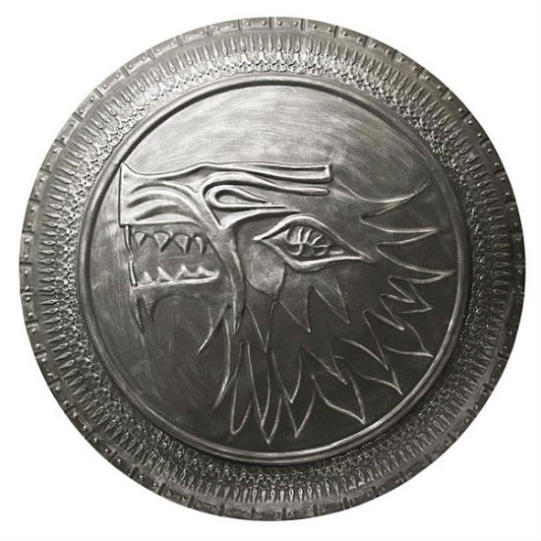
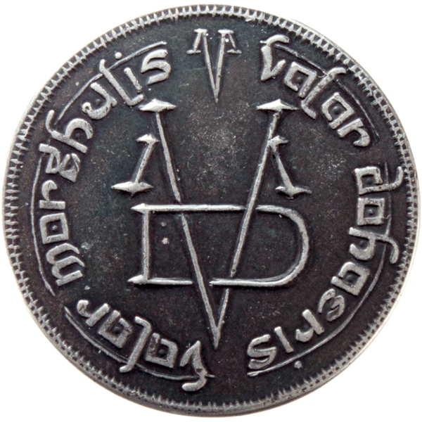
Money:
Riko
(eight of these make 1 Doragon)
Doragon
1 Doragon =0.626758 EUR =0.749977 USD
=46.878589 RUB

Slide 16
Type of economy:
A mixed economy of socialism and capitalism. With export driven economy policies. This allows a level of economic freedom in the use of capital, but allows governments to interfere in economic activities in order to achieve social aims. The government will control goods and services such as education, courts, roads, hospital care and postal delivery.

Slide 17
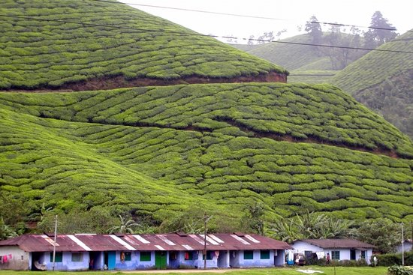
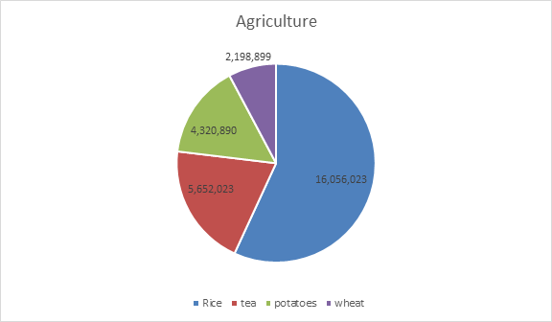
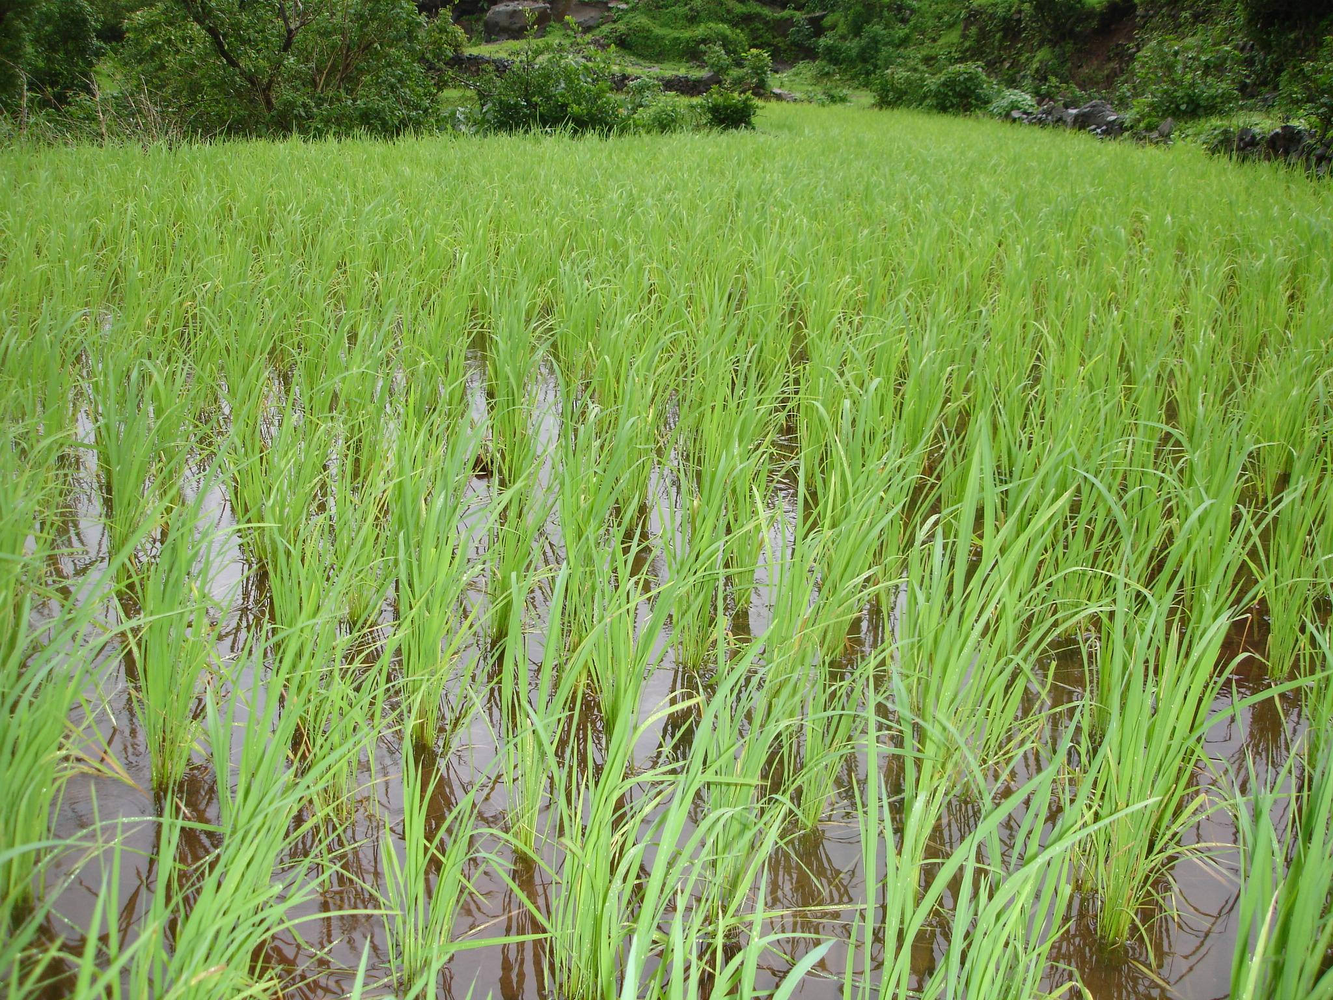
Type of agriculture:
Only 20% of the land is suitable for cultivation, but the government has made policies that benefit agriculture. In the past years the country has seen a lot of improvement in this area. In the past year the economy saw a great income through agriculture of 2.3 billion Doragons.
In tons

Slide 18
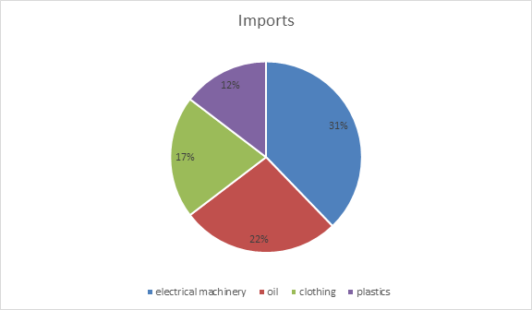
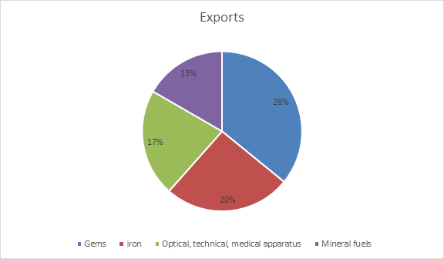
Type of industries:
With an export driven economy, the country relies heavily on what it imports and exports.
Total imported: 358.3 billion doragons were spent on imports
Total exported: 782.1 billion doragons were gained from exports

Slide 19
Introduction to the Warku banni
Translated to English: Sasei is a free country in which citizens will live happily and at peace. All citizens have to follow the laws of the Warku Banni.
Article 1
Section 1- Saisei is founded with the principles of peace and will be isolated from other countries. Except few nearby who have commercial treaties with our nation.
Article 2
Section 1- The power of the Rima will not be absolute and will be revised by the Hadolo and the Migui
Section 2- The Rima has to be elected by the Hadolo with a ⅔ majority in the chamber
Article 3
Section 1- Citizens with the age 20 or older have the right to vote for the Hadolo
Article 4
Section 1- Citizens of Yiamu, Shysenz, and Kazanzi will all be represented equally in the government with the same amount of representation. Every island has 16 representatives in the Hadolo.

Slide 20
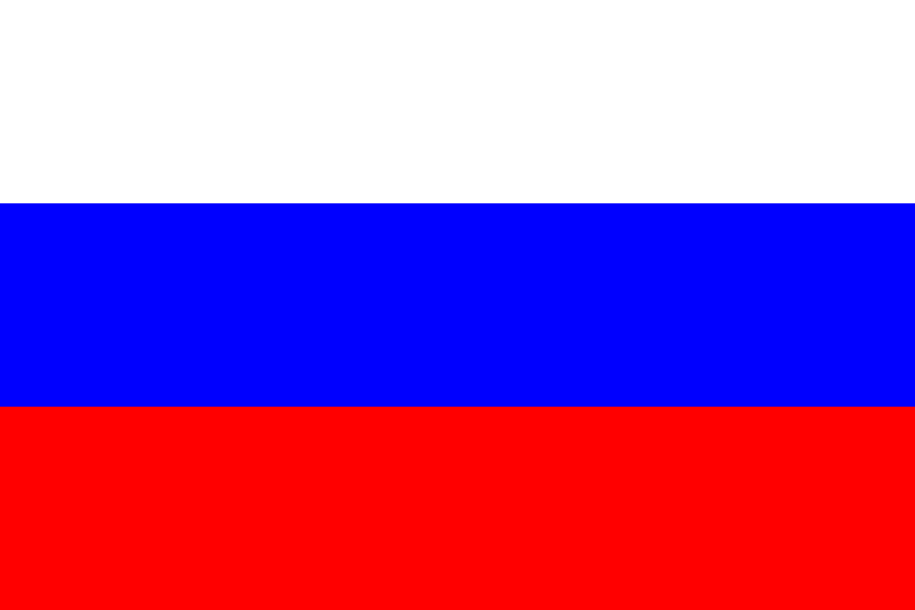
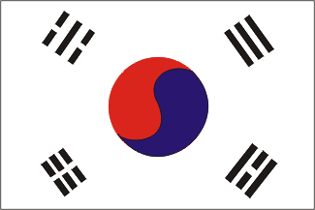
World organizations or treaties
Russia Korea Saisei Pact (RKS Treaty)- This treaty serves as a triangle free trade agreement in the region. Russia and South Korea are the only trade partners of Saisei and is only for economic purposes. The Republic of Saisei is not a political ally of these countries, as Article 1 of Warku Banni clearly prohibits.

Slide 21
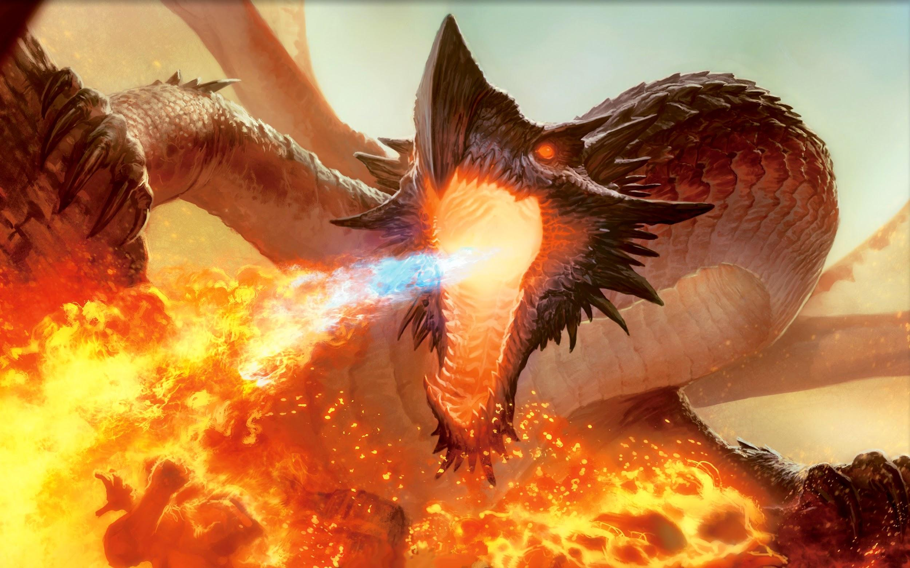
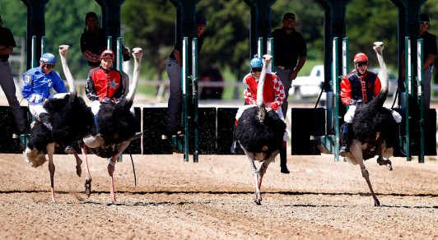
Interesting Things about Saisei
-The people have great believe that dragons existed and lived in their lands.
-There are no political parties
-The national sport is professional ostrich racing

