Slide 1
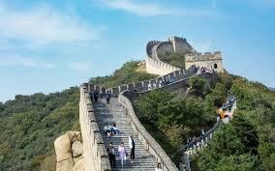
China vs South Korea
Jesus Feliciano
Carolina Santiago
Antonio Torres

Slide 2
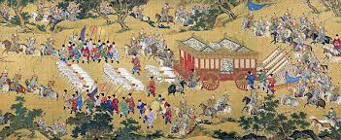
Historical Context of China’s Origin
China is one of the world's four ancient civilizations, and the written history of China dates back to the Shang Dynasty (c. 1600–1046 BC), over 3,000 years ago.

Slide 3
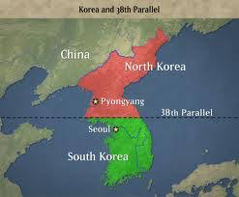
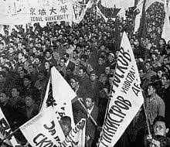
Historical Context of South Korea’s Origin
In the aftermath of the Japanese occupation of Korea which ended with Japan's defeat in World War II in 1945, a United Nations arrangement divided Korea at the 38th parallel under the administration of the Soviet Union in the north and the United States in the south.

Slide 4
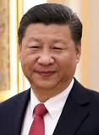
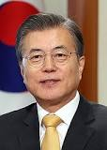
Who governs?
China: President Xi Jinping
South Korea: President Moon Jae-in

Slide 5
China type of government
The People's Republic of China is what's known as a single-party state. This means that only one party is allowed to be in control of the government.
The People’s Republic of China has been ruled by the Communist Party since 1949 when it won the Chinese Civil War by overthrowing the Nationalist government.

Slide 6
Republic of Korea type of government
Democratic Republic or a Constitutional Republic that divides into three branches: Executive, Legislative, and Judiciary. The Executive and Legislative branches operate primarily at the national level, although various ministries in the executive branch also carry out local functions. Local governments are semi-autonomous, and contain executive and legislative bodies of their own. The Judicial branch operates at both the national and local levels.

Slide 7
Origin of China’s government
After many dynasties, the modern chinese government came into power when the Communist Party defeated the Nationalist Party in 1949. The communist leader, Mao Zedong, turned almost all of China into a communist country called the People’s Republic of China. After he died, new leaders made changes including trade with more countries, new personal businesses and the ability to own property.

Slide 8
Origin of South Korea’s government
After WWII, the UN divided Korea, a Japanese territory, into the Northern and Southern sections to be looked after by the Soviet Union and US respectively. After that South Korea has been through many republics each with a different type of government than the last. The current sixth republic is a constitutional democracy that was established after public outrage over killings of students in a South Korean city consolidated nationwide support for democracy, paving the way for the first democratic elections in 1987.

Slide 9
China Structure

Slide 10
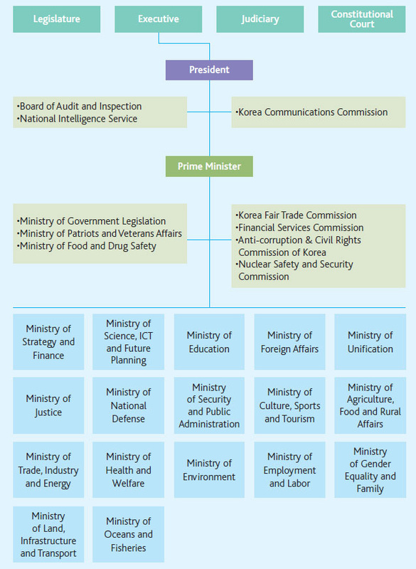
Structure South Korea

Slide 11
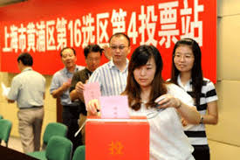
How is power obtained/transferred?
China: As a single-party system, every five years elections take place in order to pass power from the president of the nation to the upcoming leader of the Communist Party of China. Before the current leader there was a maximum of two terms per president, however the limit was eliminated by congress in 2018.

Slide 12
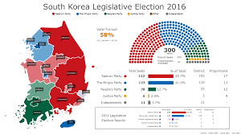
How is power obtained/transferred?
South Korea: Local elections are held every four years to elect governors, metropolitan mayors, municipal mayors, and provincial and municipal legislatures. The positions are held for a single five-year term. There are two powerful parties in the nation, with three smaller ones that earned votes in the 2017 elections.

Slide 13
How are laws/decisions made in South Korea?
Bills may be introduced by members of the National Assembly or by the Executive.
A written estimate of the anticipated expenses related to execution of the bill must be submitted with it.
When a bill is proposed or submitted, the Speaker distributes it to the National Assembly members, reports it to the plenary session, and transmits it to the competent standing committee.
After completion of examination by the standing committee, the Speaker refers it to the plenary session, or it is automatically repealed, unless thirty or more members request that it be sent to the session.

Slide 14
How are laws/decisions made in South Korea?
A bill passed by the National Assembly is transferred by the Speaker to the President, If he objects to the bill, he or she may return it to the National Assembly and request that it be reconsidered, but the President cannot propose amendments.
If the National Assembly repasses the bill in the original form with the attendance of more than one-half of the total members it becomes an act.

Slide 15
How are laws/decisions made in China?
Proposing Bills: Members of the NPC and other state actors are authorized to propose bills, which are to be placed on the agenda of the NPC.
Deliberation: The NPC hears the statements of the bill sponsor of a proposed bill, the delegations then deliberate on the bill. Based on the deliberated opinions of the delegations and the special committee, the Law Committee considers the bill and submits to the Presidium a report on the result of its deliberations containing different opinions and a revised draft law.

Slide 16
How are laws/decisions made in China?
Voting: After a revised draft law has been considered, the Law Committee further revises the draft according to the deliberated opinions of the delegations and prepares a draft for vote. A bill passes by a majority vote in the NPC.
Promulgation: After a law is passed in the NPC, it is signed by the President of the State and promulgated by an Order of the President. The President does not have a veto or discretion in signing once the law has been passed by the NPC.

Slide 17
Advantages of the countries
China:
The poverty rate is one of the lowest in the continent (3.3%)
Growth is making China a world economic leader.
Chinese tech companies such as Huawei and Lenovo have quickly become market leaders.
South Korea
Multiple political parties
Fair government
Many freedoms for the citizens

Slide 18
Disadvantages of the countries
South Korea:
Tense relationship in the Korean peninsula
A dual transition - to a consolidated democracy and an advanced market economy
South Korea has a notably high suicide rate, partially as a result of the very stressful atmosphere surrounding education.
Declines in monetary and labor freedoms
China:
Single-party system
Government spending is high
Lack of fair social service system
China is famous for its lack of internet and media freedom as well as lack of respect for activists and religious groups

Slide 19
Other differences
While China has been considered a powerful country for decades, South Korea has only just begun being considered a respected democracy.
In South Korea, the Christianity is widely followed and plays an important role in society, although South Korea is still very secular. Modern China is managed by China Communist Party. It has very negative attitudes toward traditional culture. They destroyed a lot of traditional culture in "Cultural Revolution" from 1966 to 1976. Therefore, South Korea is more traditional and conservative than China.

