Slide 1
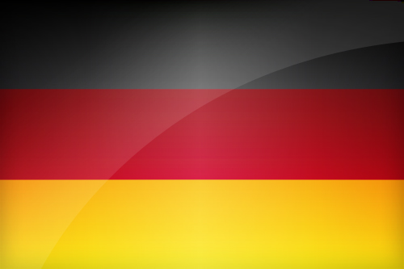
GERMAN GOVERNMENT
Bundesregierung / The Federal Government APCGP

Slide 2
Germany is a republic with a parliamentary democracy and a bicameral system of government.
The Federal Government consists of the Chancellor and his or her ministers who are drawn from the members of the Bundestag. The ministers usually belong to the parties who form the ruling coalition.
www.bundesregierung.de

Slide 3
Bundestag / The Federal Parliament
The Bundestag is made up of representatives elected by the German people. Their main tasks are to draft and pass legislation, approve the national budget and to vote on the deployment of the German army (Bundeswehr). The members of the Bundestag are elected by the people of Germany. Elections to the Bundestag take place every four years.
Elections are carried out using a system of proportional representation. As a result, it is difficult for one party to gain an overall majority and coalition government is the norm. To prevent the splintering of parties or a radical party gaining power, parties have to obtain more than five percent of the vote.
www.bundestag.de

Slide 4
Bundesrat / The Federal Council
The Bundesrat is the second chamber of the German parliament and represents the federal states’ interests at national level. There are 69 members of the Bundesrat. The Bundesrat is involved in creating and approving legislation.
www.bundesrat.de

Slide 5
Bundespräsident / The Federal President
The Federal President is elected by the Bundesversammlung (made up of representatives of the Bundestag and an equal number of representatives from the state parliaments) for a period of five years. The Federal President is the head of the German state. His roles are mainly ceremonial, representing the country both at home and abroad. However, he also has the power to appoint and dismiss the Chancellor.
www.bundespraesident.de

Slide 6
Germany is a parliamentary democracy. The government policy is determined by the head of government and the ministers, and not by the head of state. Given the high standards with regard to the constitutional state and democracy as a result of the Basic Law, the Federal Constitutional Court is a player in the European political arena.

Slide 7
The court has illustrated on several occasions that European law must satisfy the criteria of the Basic Law if Germany is to relinquish to the EU the rights to draw up its own laws. In this respect to a certain extent the “eternal guarantee” of applicable principles with regard to the Basic Law vie with the Basic Law’s commitment to European integration. In June 2009 the Federal Constitutional Court stated that the Bundestag must also be substantially involved in European decision making even if it is not called on as a ratification organ for the European treaties.

Slide 8
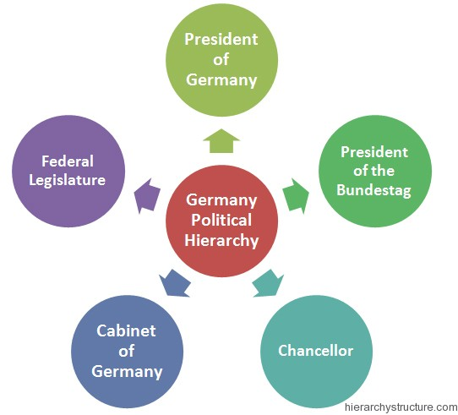

Slide 9
The federal structure
The German federal state is a complex entity. It consists of a central Federal Government and 16 federal states. The Basic Law lays out which issues fall within the ambit of the Federal Government and which devolve to the federal states. As such the federal system in Germany is similar to that of other federal countries.

Slide 10
Public life in Germany is predominantly based on central laws. In accordance with the principle of subsidiarity citizens, on the other hand, deal almost exclusively with state and local authorities acting on behalf of the federal states. The reason for this is the aim of the Basic Law to combine the advantages of a unified state with those of a federal state. In everyday life the citizens of other federal states have far more frequent dealings with representatives of central government.

Slide 11
The Basic Law stipulates that it be possible to compare living conditions throughout Germany. Essentially these are determined by economic and social policy. With regard to financial policy the German constitution accords the federal states considerable leeway in the financing of their duties. All high-revenue taxes are decreed by law, though this needs the approval of the Bundesrat, which represents the states at federal level. Part of these taxes goes to central government alone or to the federal states and another part, including the particularly lucrative taxes, is divided up between central government and the federal states.

Slide 12
To this extent the German federal state resembles a centralized state. Nonetheless it is the federal states that control the major part of pan-state administration. This means that federalist elements dominate the state administrative systems. First, its own administrative system enforces the laws that apply in that particular state. In addition they also execute most central laws.

Slide 13
Given the large number of duties passed down from central government to the federal states several of them have, in the past, had to take on enormous debts. In 2009 an amendment was made to the constitution forbidding them to raise further loans as of 2020 and limiting the amount of new debts central government can take on from 2016 – with a proviso for economic crisis situations – to a maximum of 0.35 percent of the gross domestic product (the debt ceiling).

Slide 14
There are three pan-state functions the individual federal states exercise on their own: schooling and tertiary education, internal security, including policing, as well as the organization of local self-government. Thanks to the wide-ranging rights pertaining to guaranteed participation they enjoy in the Bundesrat, the federal states receive a form of compensation for the fact that central government is the primary body determining legislation.

Slide 15
Basic Law
After it had been approved by the Parliamentary Council, the Basic Law came into force on May 23, 1949. It sets out the fundamental legal and political order of the Federal Republic of Germany. The basic rights enshrined in the Basic Law are of particular importance – first and foremost Article 1. This postulates the respect of human dignity as the highest asset of the constitutional order.

Slide 16
The Basic Law determines that Germany is a constitutional state:
All state authorities are subject to judicial control. Section 1 of the Basic Law is of particular relevance. It stipulates that respect for human dignity is the most important aspect of the constitution:
“Human dignity shall be inviolable. To respect and protect it shall be the duty of all state authority.”
Among other things, the other basic rights guarantee the freedom to act within the law, equality before the law, freedom of the press and media, freedom of association and protection of the family.

Slide 17
In determining that it is the people who exercise power through special bodies, the Basic Law lays down representative democracy as the form of rulership.
Furthermore, it determines that Germany is a constitutional state:
All state authorities are subject to judicial control. Another principle of the constitution is that Germany is a federal state, in other words the ruling authorities are divided up into a number of member states and the central state.

Slide 18
In conclusion, the Basic Law defines Germany as a welfare state. The welfare state requires the political system to take precautions such that people are guaranteed a decent standard of material well-being in case of unemployment, disability, illness and in old age.

Slide 19
One particular feature of the Basic Law is the “eternal character” of these governing constitutional principles. Subsequent alterations to the Basic Law or a completely new constitution cannot encroach on the basic rights, the democratization of sovereignty, the federal state and the welfare state.

Slide 20
The political parties
According to the Basic Law it is the task of the political parties to participate in political will formation by the people. As such, putting forward candidates for political office and the organization of election campaigns both have the status of constitutional tasks. For this reason the parties are reimbursed the costs they incur in their respective election campaign.

Slide 21
The reimbursement of election campaign costs, a feature Germany was the first country to introduce, is now commonplace in most democracies. According to the Basic Law, a political party’s internal organization must conform to democratic principles (member democracy). And all parties are expected to acknowledge the values and structure of the democratic state.

Slide 22
Parties whose commitment to democracy is in doubt can, at the request of the Federal Government, be banned from participation in the country’s political life. Should the Federal Government consider a ban to be appropriate because such parties pose a threat to the democratic system, it can only petition for such a ban. Any such ban may only be enacted by the Federal Constitutional Court after duly considering the individual case. The idea is to prevent the ruling parties simply banning those parties who might prove awkward in the fight for votes.

Slide 23
In the history of the Federal Republic there have been few banning processes, and even fewer parties have actually been banned. Though the Basic Law accords political parties some privileges, these are, basically, means for society to express itself.

Slide 24
The German party system is quite transparent. Through the establishment of the Greens in the 1980s and, following unification in 1990, the successor party to the SED, a long-standing tri-party system has now developed into a five-party system. Alongside the “popular” parties CDU/CSU and SPD the “minor” parties also won a double-digit percentage of the votes cast in the 2009 elections to the Bundestag.

Slide 25
With the exception of Bavaria, throughout Germany the Union parties, and they are both members of the European Christian Democrat group of parties, stand as the Christian Democratic Union. The CDU itself declines to stand in Bavaria, preferring to leave the region to the Christian Social Union, with which it is closely allied. In the Bundestag the members of parliament of both parties have joined forces to create a permanent parliamentary party.

Slide 26
The Social Democratic Party of Germany is the other major force in the German party system. It belongs to the European group of Social Democratic and democratic socialist parties. CDU/CSU and SPD support a welfare state. Whereas the CDU/CSU attract the self-employed, businessmen and entrepreneurs, the SPD has close links to the unions.

Slide 27
The Free Democratic Party belongs to the European group of liberal parties. Its political creed is that of the state being involved as little as possible in the economy. The FDP receives backing primarily from well-educated high-earners.

Slide 28
The Greens belong to the European group of green and ecological parties. The characteristic feature of their program is the combination of market economy and decrees pertaining to nature and environment protection that must be monitored by the state. They too represent higher-income voters with an above-average standard of education.

Slide 29
The Left Party is the most recent important political party in Germany. It is particularly strongly represented in the five federal states that acceded to the Federal Republic on unification. In the remaining states as well, however, it is now represented in the state parliaments. As a party that propagates social justice it competes primarily with the SPD.

Slide 30
The German electoral system makes it very difficult for any one party to form a government on its own. This has only happened once in 56 years. An alliance of parties is the general rule. So that the voters know which partner the party they voted for is considering governing with, the parties mostly issue coalition statements before embarking on the election campaign.
By voting for a particular party citizens thus express on the one hand a preference for a specific party alliance, and on the other determine the balance of power between the desired future partners in government.

Slide 31
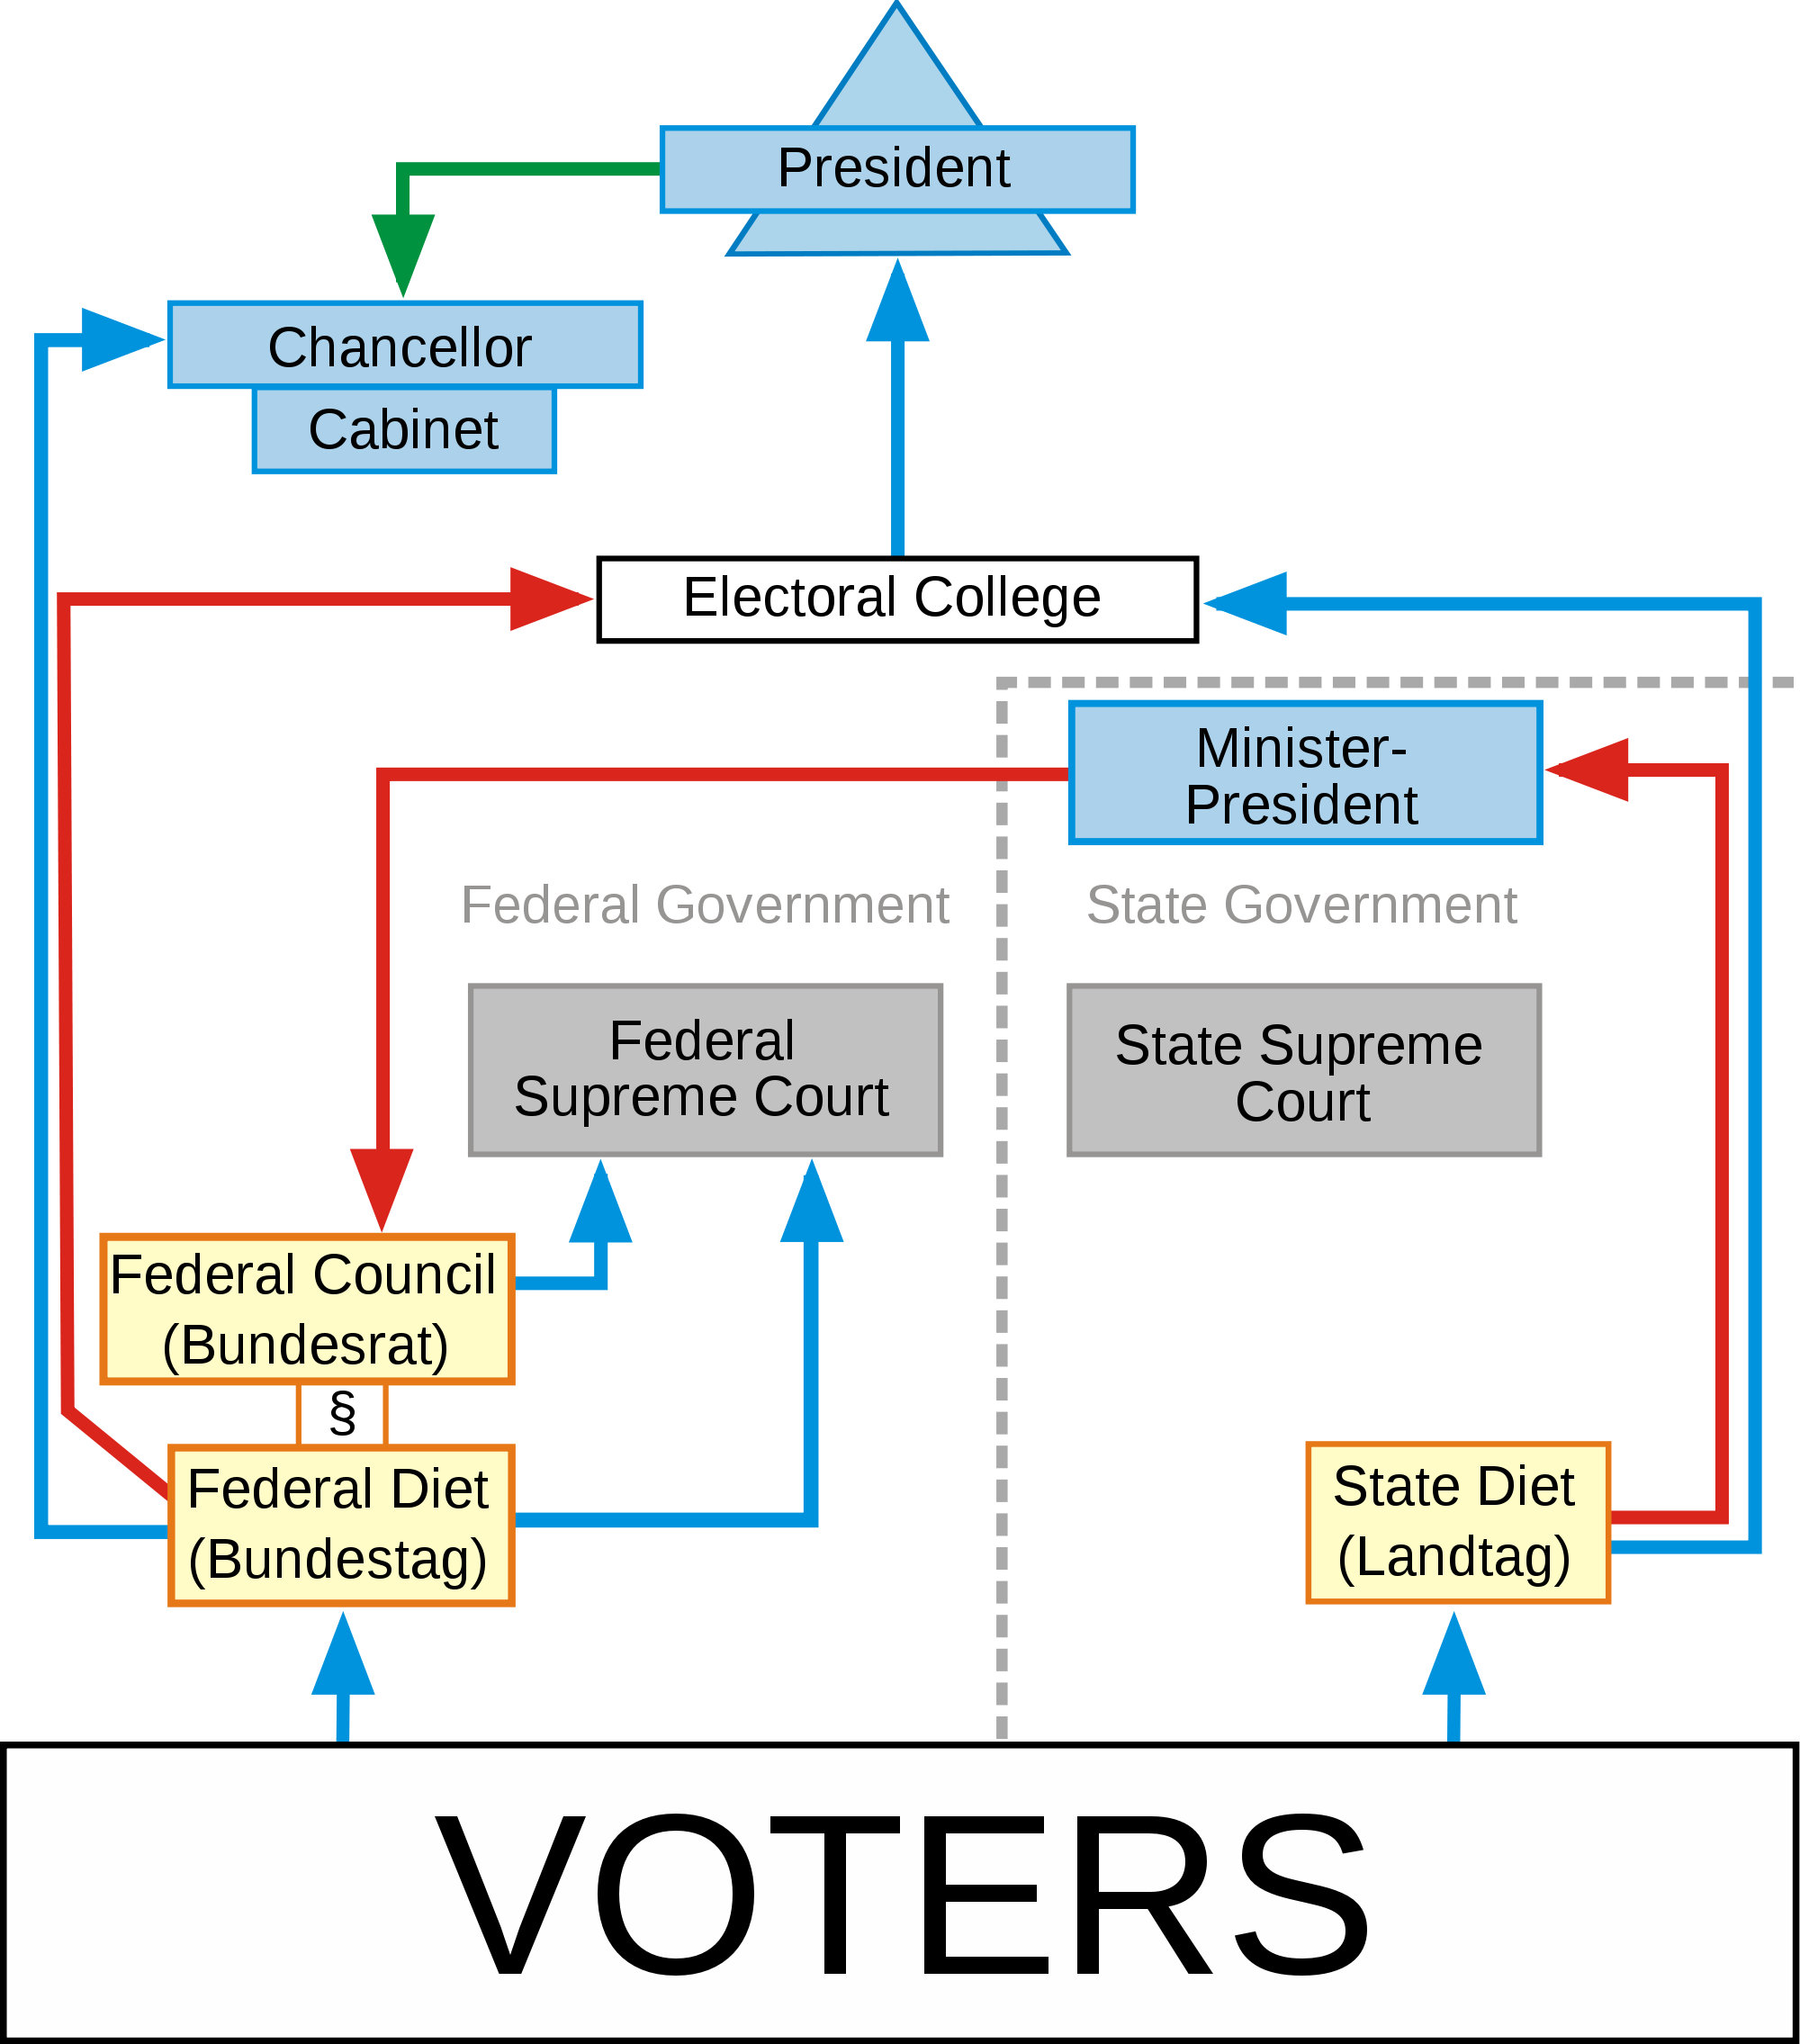

Slide 32
The electoral system
The Bundestag
The Bundestag is the elected representation of the German people. Half the 598 seats in the Bundestag are allocated by means of the parties’ state lists (the second vote) and the other half by the direct election of candidates in the 299 constituencies (the first vote).
Only those candidates who belong to a party have any chance of success. The party to whom members of the Bundestag belong is meant to reflect the distribution of votes. In order to prevent complications in the formation of majorities by the presence of small and very small parties a five-percent threshold is designed to stop their being represented in the Bundestag.

Slide 33
The Bundestag is the German parliament. Its elected representatives are organized in parliamentary parties and select a President from among them. It is the function of the Bundestag to elect the Federal Chancellor and keep him in office through support for his policies.
The members of parliament can relieve the Chancellor of his duties by denying him their confidence, as do other parliaments. Nor does it make any great difference that in Germany the Chancellor is elected, whereas in Great Britain and other parliamentary democracies he is appointed by the head of state. In other parliamentary democracies, a party leader who can rely on a parliamentary majority is always appointed head of government.

Slide 34
The Bundesrat
The Bundesrat represents the federal states and alongside the Bundestag is a form of Second Chamber. It is obliged to deliberate on each federal law. As the chamber of the federal states, the Bundesrat has the same function as those Second Chambers in other federal states that are mostly referred to as the Senate.
The Bundesrat is made up exclusively of representatives of the federal state governments. The number of votes each state holds is aligned in a sense to the size of its population: Each state has at least three, and those with the highest populations up to six.

Slide 35
The Bundesrat plays a part in the passing of federal legislation. Here, it differs from the Second Chamber of other federal states. The Basic Law envisages two forms of participation.
Central laws that cause the federal states additional administrative costs or replace existing central laws require the approval of the Bundesrat: The latter is required to endorse laws passed by the Bundestag for these to become legally binding. In this regard, the Bundesrat enjoys the same rights as the Bundestag in terms of being a legislative organ. Currently almost 50 percent of all laws passed require the approval of the Bundesrat.

Slide 36
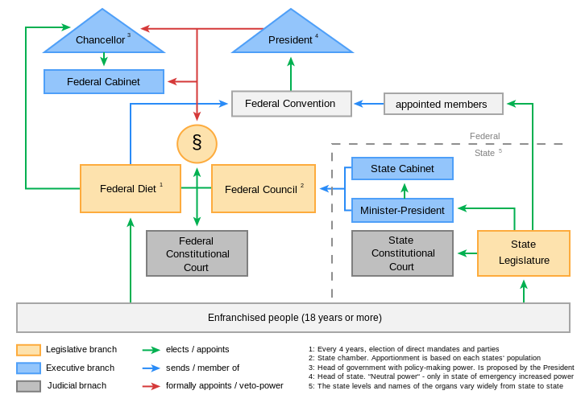

Slide 37
Since federal laws are in principle enforced by the administrative bodies of the federal states, the most important and most costly laws involve the administrative sovereignty of the federal states.
A difference should be made between these approval laws and the appeal laws. Though the Bundesrat can reject the latter, the Bundestag can overrule the objection with the same majority as in the Bundesrat, with a simple or two-thirds majority, in the event of the latter with at least the majority of the members of the Bundestag (absolute majority).

Slide 38
Since September 2006, the reform of the federal system has recalibrated the respective scope of central government and of the individual federal states. The goal of the reform: to improve the decision-making abilities and scope for action of both central government and the federal state governments, and to more clearly assign political responsibilities.

Slide 39
Political system
It fast became a successful model and a prime export: After the Second World War, the Basic Law provided freedom and stability – albeit initially only for the Germans in the West of the nation that remained divided until 1990.
The primacy of the basic rights, the definition of the principles of a democratic and social federal state, and the foundation of a supreme court that watches over adherence to the constitution – these are the basic cornerstones of German democracy.

Slide 40
http://www.ukgermanconnection.org/politics-german-government

