Slide 1
Presidents of the United States of America in the 20th Century
MODERN ERA PRESIDENCIES AND THEIR LEGACY
Prof. Ruthie García Vera
AP US History

Slide 2
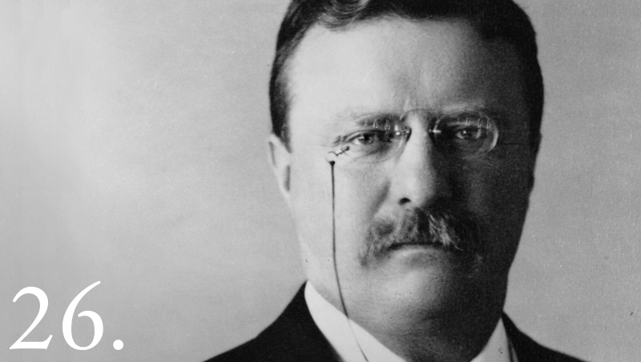
Theodore Roosevelt
26th President of the United States
1901-1909
"We must dare to be great; and we must realize that greatness is the fruit of toil and sacrifice and high courage."

Slide 3
Theodore Roosevelt became the youngest President in the Nation's history after the assassination of President William McKinley. He lead Congress and the American public toward progressive reforms and a strong foreign policy.
During the Spanish-American War, Roosevelt was lieutenant colonel of the Rough Rider Regiment, which he led on a charge at the battle of San Juan in Cuba.
Roosevelt emerged as a "trust buster" by forcing the dissolution of a great railroad combination in the Northwest. Other antitrust suits under the Sherman Act followed.
Roosevelt steered the United States more actively into world politics. He liked to quote a favorite proverb, "Speak softly and carry a big stick. . . . “

Slide 4
Roosevelt ensured the construction of the Panama Canal for a shortcut between the Atlantic and Pacific oceans.
His corollary to the Monroe Doctrine prevented the establishment of foreign bases in the Caribbean and arrogated the sole right of intervention in Latin America to the United States.
He won the Nobel Peace Prize for mediating the Russo-Japanese War, reached a Gentleman's Agreement on immigration with Japan, and sent the Great White Fleet on a goodwill tour of the world.
Some of Theodore Roosevelt's most effective achievements were in conservation. He added land protection to the national forests in the West, reserved lands for public use, and fostered great irrigation projects.

Slide 5
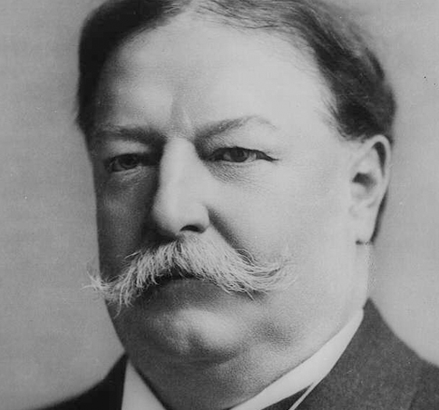
William Howard Taft
27th President of the United States
1909-1913
"Don't write so that you can be understood, write so that you can't be misunderstood."

Slide 6
Taft continued all of Roosevelt's big stick policy in Latin America and added his own new policy termed Dollar Diplomacy. This policy called for investors in the United States to invest in other (less developed) countries of the world in order to help them develop and in the process make those countries more dependent on the United States.
Dollar Diplomacy allowed the United States to maintain its grip on Latin America and denied Europe the ability to benefit from Latin American countries while the United States benefited from them. It also helped less developed countries become more developed providing the capital necessary to help them develop. However, in the process they just became more dependent on the United States.
William Howard Taft later became the tenth Chief Justice of the United States, the only person to have served in both of these offices.

Slide 7
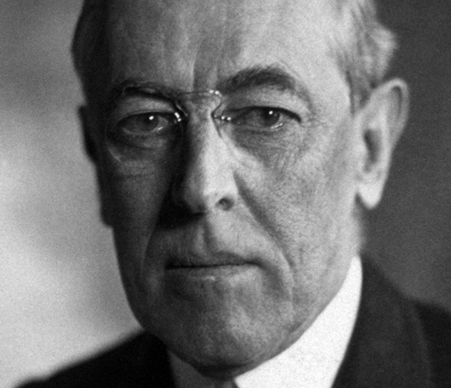
Woodrow Wilson
28th President of the United States
1913-1921
"One cool judgment is worth a thousand hasty counsels. The thing to be supplied is light, not heat."

Slide 8
Woodrow Wilson, a leader of the Progressive Movement, was the 28th President of the United States (1913-1921). After a policy of neutrality at the outbreak of World War I, Wilson led America into war in order to "make the world safe for democracy."

Slide 9
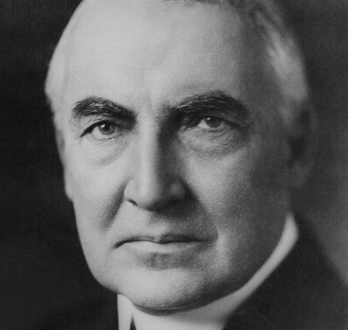
Warren G. Harding
29th President of the United States
1921-1923
"America's present need is not heroics, but healing; not nostrums, but normalcy; not revolution, but restoration; not agitation, but adjustment; not surgery, but serenity…”

Slide 10
Warren G. Harding, an Ohio Republican, was the 29th President of the United States (1921-1923). Though his term in office was fraught with scandal, including Teapot Dome, Harding embraced technology and was sensitive to the plights of minorities and women.

Slide 11
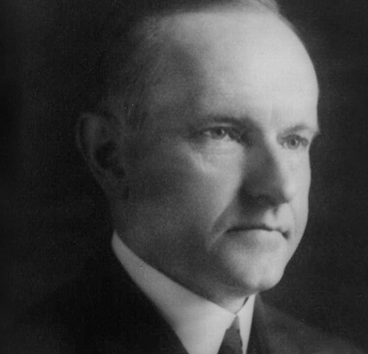
Calvin Coolidge
30th President of the United States
1923-1929
"Nothing in the world can take the place of persistence. Talent will not; nothing is more common than unsuccessful men with talent…”

Slide 12
As America's 30th President (1923-1929), Calvin Coolidge demonstrated his determination to preserve the old moral and economic precepts of frugality amid the material prosperity which many Americans were enjoying during the 1920s era.

Slide 13
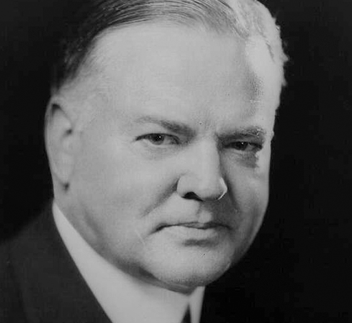
Herbert Hoover
31st President of the United States
1929 - 1933
"Older men declare war. But it is youth that must fight and die. And it is youth who must inherit the tribulation, the sorrow and the triumphs that are the aftermath of war."

Slide 14
Before serving as America's 31st President from 1929 to 1933, Herbert Hoover had achieved international success as a mining engineer and worldwide gratitude as "The Great Humanitarian" who fed war-torn Europe during and after World War I.

Slide 15
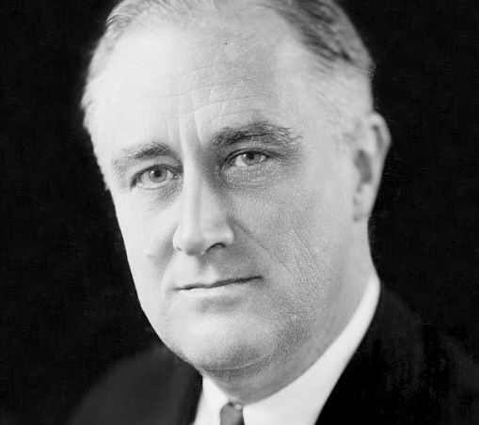
Franklin D. Roosevelt
32nd President of the United States
1933 - 1945
"Yours is not the task of making your way in the world, but the task of remaking the world which you will find before you."

Slide 16
Assuming the Presidency at the depth of the Great Depression as our 32nd President (1933-1945), Franklin D. Roosevelt helped the American people regain faith in themselves.

Slide 18
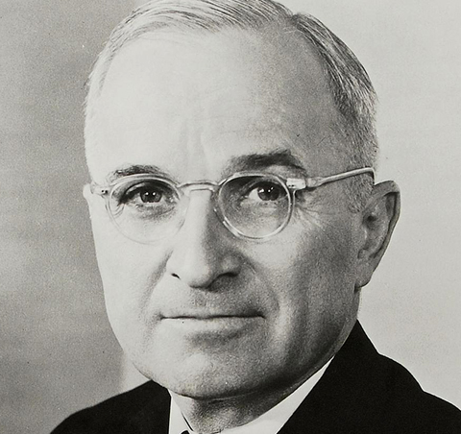
Harry S. Truman
33rd President of the United States
1945 - 1952
"I have found the best way to give advice to your children is to find out what they want and then advise them to do it."

Slide 19
During his few weeks as Vice President, Harry Truman scarcely saw President Franklin Roosevelt, and received no briefing on the development of the atomic bomb or the unfolding difficulties with Soviet Russia. Suddenly these and a host of other wartime problems became Truman's to solve when, on April 12, 1945, he became America's 33rd President.

Slide 20
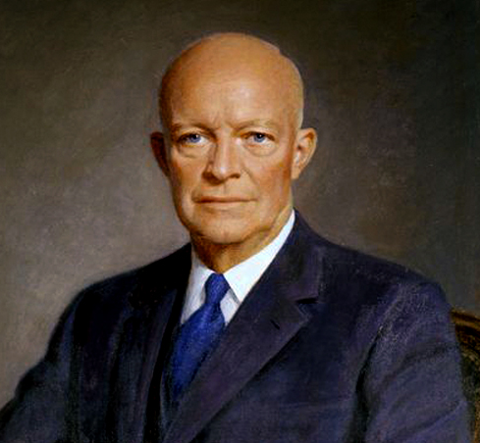
Dwight D. Eisenhower
34th President of the United States
1952- 1961
"Neither a wise man or a brave man lies down on the tracks of history to wait for the train of the future to run over him."

Slide 21
Eisenhower was commanding general of the military forces in Europe during World War II, obtained a truce in Korea and worked incessantly during his two terms (1953-1961) to ease the tensions of the Cold War.

Slide 22
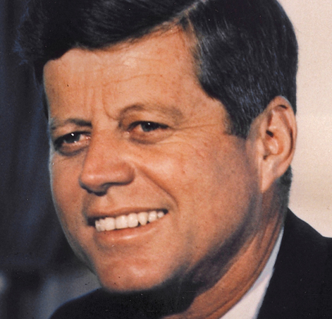
John F. Kennedy
35th President of the United States
1961-1963
"Life is never easy. There is work to be done and obligations to be met — obligations to truth, to justice, and to liberty."

Slide 23
John F. Kennedy was the 35th President of the United States (1961-1963), the youngest man elected to the office. On November 22, 1963, JFK was assassinated in Dallas, Texas, becoming also the youngest President to die.

Slide 24
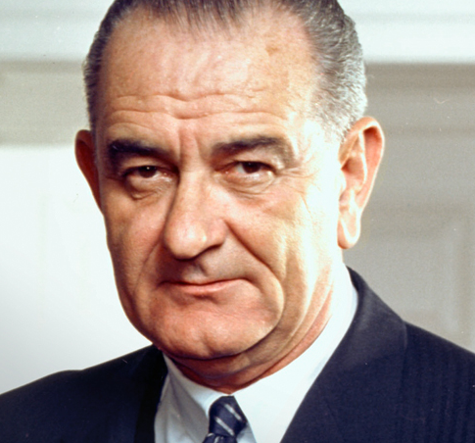
Lyndon B. Johnson
36th President of the United States
1963 - 1969
"If we succeed, it will not be because of what we have, but it will be because of what we are; not because of what we own, but, rather because of what we believe."

Slide 25
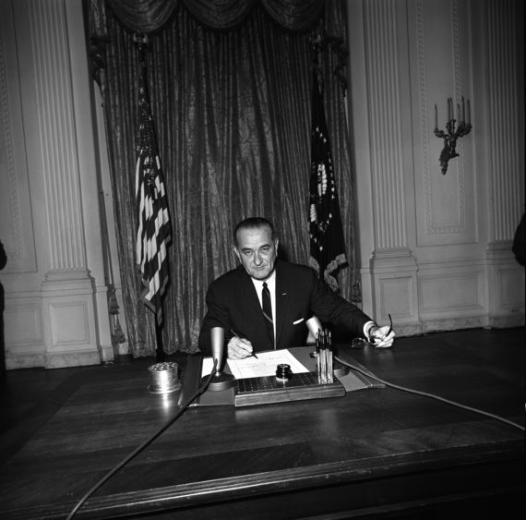
In the 1960 Lyndon B. Johnson was elected Vice President as John F. Kennedy's running mate. On November 22, 1963, when Kennedy was assassinated, Johnson was sworn in as the 36th United States President, with a vision to build "A Great Society" for the American people.
On August 2, 1964, North Vietnamese torpedo boats attacked an American Destroyer, the USS Maddox in the Gulf of Tonkin. On August 7th, the U.S. Congress almost unanimously passed the "Gulf of Tonkin Resolution." signed by President Johnson on August 10, which began a major escalation of the Vietnam War.

Slide 26
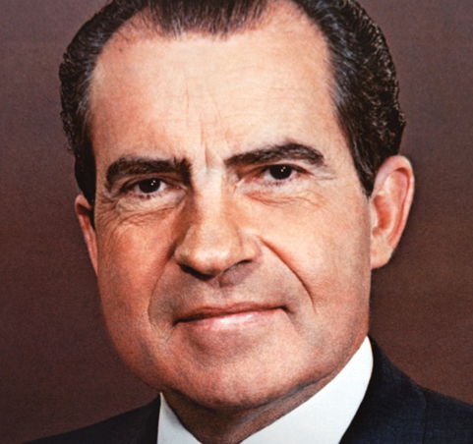
Richard M. Nixon
37th President of the United States
1969-1974
"The American dream does not come to those who fall asleep."

Slide 27
Richard Nixon was elected the 37th President of the United States (1969-1974) after serving as a Representative and a Senator from California. After successfully ending the war in Vietnam and improving relations with the U.S.S.R. and China, he became the only President to ever resign the office, as a result of the Watergate scandal.

Slide 28
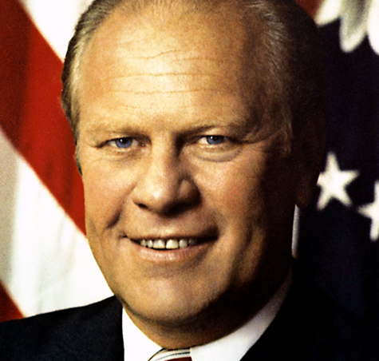
Gerald R. Ford
38th President of the United States
1974- 1977
"The founding of our Nation was more than a political event; it was an act of faith, a promise to Americans and to the entire world…”

Slide 29
When Gerald R. Ford took the oath of office on August 9, 1974 as our 38th President, he declared, "I assume the Presidency under extraordinary circumstances...This is an hour of history that troubles our minds and hurts our hearts."

Slide 30
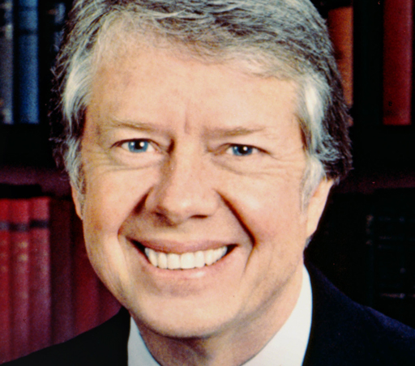
James Carter
39th President of the United States
1977 - 1981
"Piling up material goods cannot fill the emptiness of lives which have no confidence or purpose."

Slide 31
Jimmy Carter served as the 39th President of the United States from 1977 to 1981. He was awarded the 2002 Nobel Peace Prize for work to find peaceful solutions to international conflicts, to advance democracy and human rights, and to promote economic and social development.

Slide 32
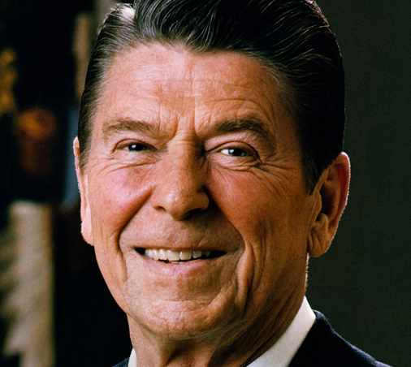
Ronald Reagan
40th President of the United States
1981 - 1989
"The future doesn't belong to the fainthearted; it belongs to the brave."

Slide 33
Ronald Reagan, originally an American actor and politician, became the 40th President of the United States serving from 1981 to 1989. His term saw a restoration of prosperity at home, with the goal of achieving "peace through strength" abroad.

Slide 34
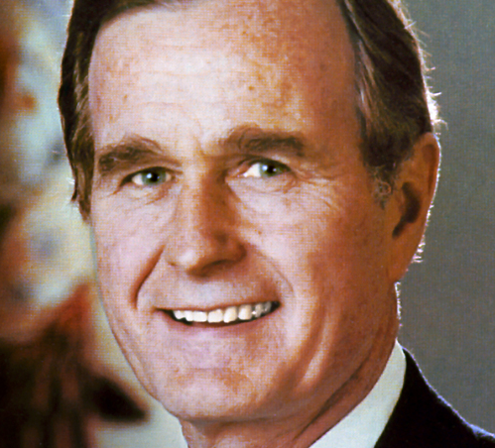
George H. W. Bush
41st President of the United States
1989-1993
"No problem of human making is too great to be overcome by human ingenuity, human energy, and the untiring hope of the human spirit."

Slide 35
George H. W. Bush, as the 41st President (1989-1993), brought to the White House a dedication to traditional American values and to making the United States "a kinder and gentler nation" in the face of a dramatically changing world.

Slide 36
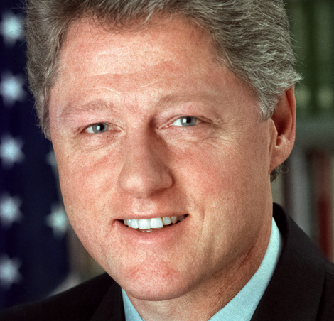
William J. Clinton
42nd President of the United States
1993-2001
"If you live long enough, you'll make mistakes. But if you learn from them, you'll be a better person. It's how you handle adversity, not how it affects you.”

Slide 37
Bill Clinton is an American politician from Arkansas who served as the 42nd President of the United States (1993-2001). He took office at the end of the Cold War, and was the first baby-boomer generation President.

Slide 38
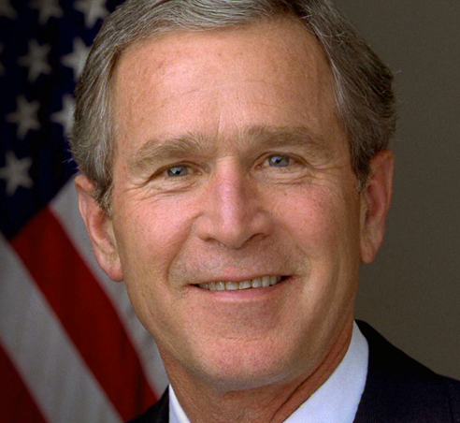
George W. Bush
43rd President of the United States
2001-2009
"Life takes its own turns, makes its own demands, writes its own story, and along the way, we start to realize we are not the author."

Slide 39
George W. Bush, America's 43rd President (2001-2009), was transformed into a wartime President in the aftermath of the airborne terrorist attacks on September 11, 2001, facing the "greatest challenge of any President since Abraham Lincoln."

Slide 40
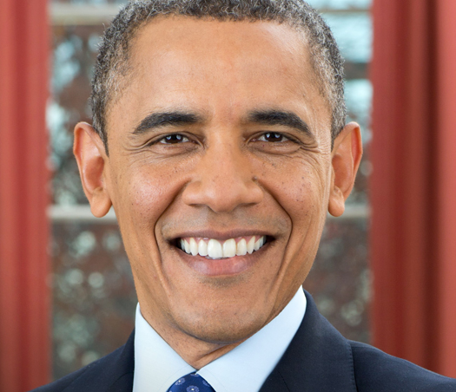
Barack Obama
44th President of the United States
2009- present
"One voice can change a city . And if it can change a city, then it can change a state… And if it can change a state, it can change a nation, and if it can change a nation, it can change the world. Your voice can change the world."

Slide 41
Barack Obama is the 44th President of the United States. His story is the American story -- values from the heartland, a middle-class upbringing in a strong family, hard work and education as the means of getting ahead, and the conviction that a life so blessed should be lived in service to others.

